Slide 1
Please note that for new colleagues attending this meeting, we will be adding your contact details, as provided, to our internal SWRI address database, https://www.swri.co.uk/privacy-policy.html
The webinar will be recorded and placed on the SWRI Extranet for future viewing.
The webinar will be held in accordance with the Competition Law requirements of normal SWRI committee meetings. Members must not discuss any commercially sensitive information, including but not limited to information which is confidential to their own company and/or is relevant to the commercial strategy or activities of their company. This restriction applies during the formal meeting and in any discussions or exchanges around or relating to the meeting. Members are in the best position to judge what is commercially sensitive or confidential and so the primary responsibility for compliance lies with members. Failure to comply may have serious consequences for the individuals involved, their companies and the SWRI itself. Such consequences can include substantial fines and the imposition of criminal penalties including imprisonment.

Slide 2
Quality Control
Hannah Ford
SWRI Service Group

Slide 3
Summary
PART 1:

Slide 4
General Lab Checks Balances
Internal vs external

Slide 5
General Lab Checks Pipettes
Internal vs external

Slide 6
General Lab Checks Volumetric Flasks

Slide 7
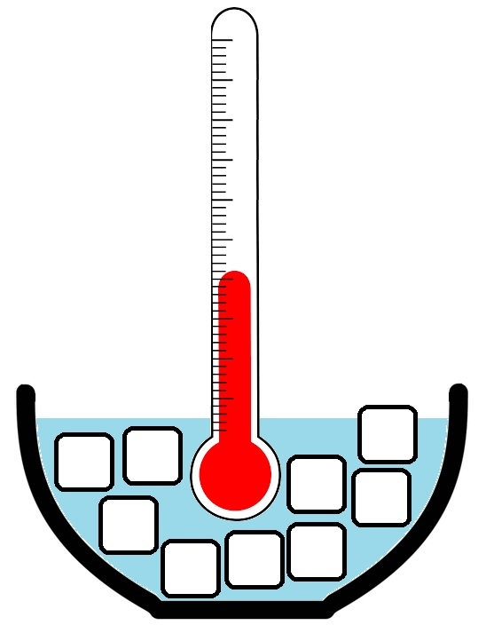
General Lab Checks Thermometers
Notes:
Internal vs external

Slide 8
General Lab Checks Other Temperature Loggers

Slide 9
General Lab Checks Instruments – External/Preventative maintenance
Service contracts

Slide 10
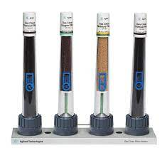
General Lab Checks Instruments – Gas filters

Slide 11
General Lab Checks Chemicals and Standards
Notes:
CoA
Expiry dates
Quality/purity (mobile phases, solvents)
Extension when necessary – how to justify. What’s appropriate to each lab (vs eg cost of chemical)

Slide 12
calibrations
Internal and external standards
Notes:
Checks in place for new ones
Deuterated IS

Slide 13
Analytical Sequences – Inclusion of QC Samples
Why we use QC samples
What should the QC sample be
Storage/expiry/stability
Multiple/different matrices/levels
Compromise on ideal QC
Natural levels vs spiked recovery (SQC vs AQC)
Where to put QC samples in your sequence
Bracketing standards
Non-routine methods – spike
Independence of spiking standards

Slide 14
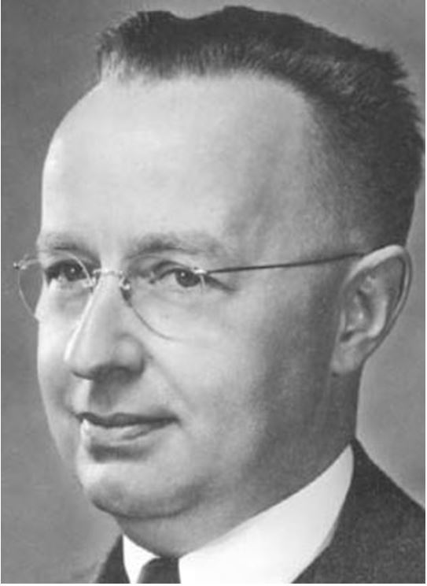
Walter A. Shewhart 1891 - 1967
Quality control in manufacturing
Devised the control chart system in 1924
“Assignable-cause” vs “chance-cause” or “Special-cause” vs “common-cause”
A process in “statistical control” has ONLY common-cause variation
www.magazine.amstat.org
Notes:
In 1924 Shewhart was working for the Inspection Engineering Department of Western Electric, which manufactured hardware for the Bell Telephone Company. Quality control at the time was limited to inspecting finished products and removing defective items. The company had realised that adapting processes reactively to every non-conforming product was actually counter-productive – increasing variability and resulting in more defections. So Shewhart set out to devise a system to distinguish between what he called “assignable-cause” and “chance-cause” variation (these terms were later on renamed to “special-cause” and “common-cause”) – this system being what we would recognise today as a control chart.

Slide 15
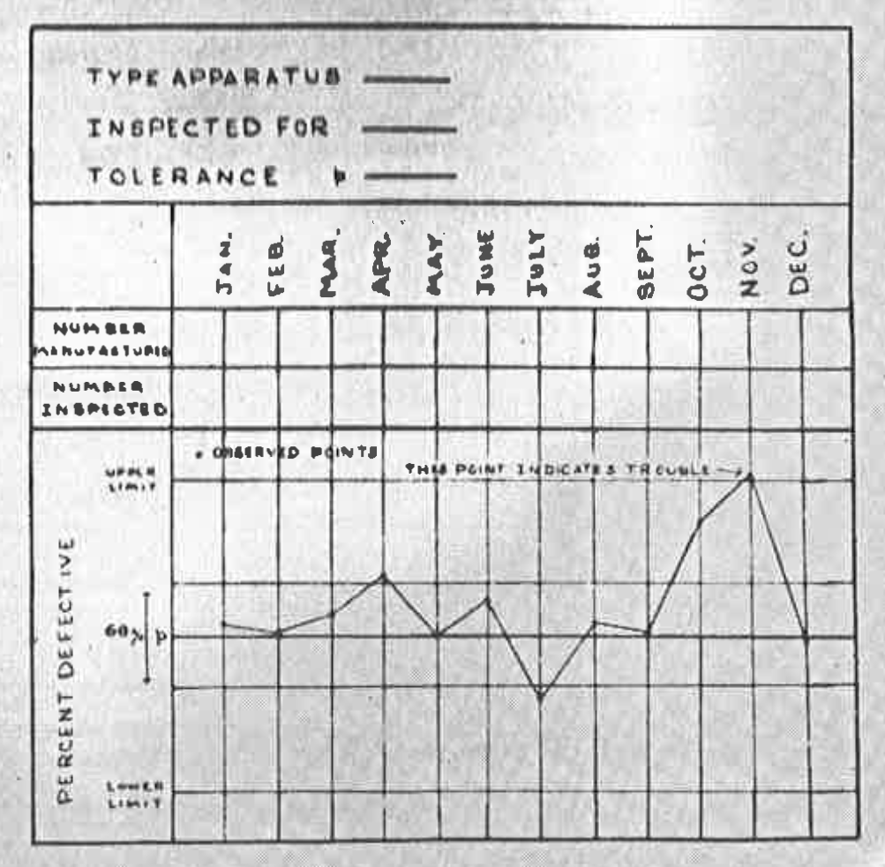
The First Control Chart 1924
A few days ago, you mentioned some of the problems connected with the development of an acceptable form of inspection report which might be modified from time to time, in order to give at a glance the greatest amount of accurate information.
The attached form of report is designed to indicate whether or not the observed in the percent of defective apparatus of a given type are significant; that is, to indicate whether or not the product is satisfactory. The theory underlying method of determining the significance of the variations is the value of p is somewhat involved when considered in such a form as to cover practically all types of problems. I have already started the preparation of a series of memoranda covering these points in detail. Should it be found desirable, however, to make use of this form of chart in any of the studies now being conducted within the Inspection Department, it will be possible to indicate the method to be followed in the particular examples.
– – W. A. Shewhart
www.deming.org
Notes:
Other applications – process quality control also applicable.
How much does Barry know about process control charts (as opposed to analytical) and software packages used? Richard Cowley @ Diageo (Leven pilot plant) Jane Millar

Slide 16
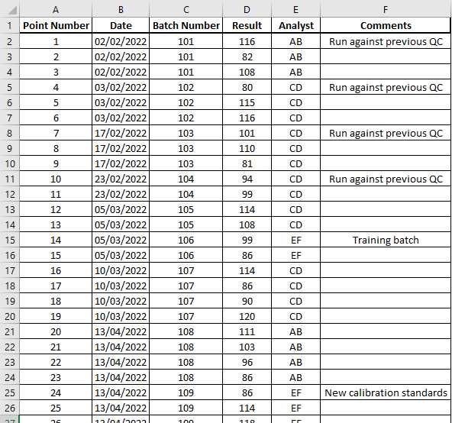
Control Chart Setup
Notes:
How much data is needed for meaningful
Running in new sample alongside old
When to restart a chart

Slide 17
Control Chart Setup
Result
Repetition number (or date)

Slide 18
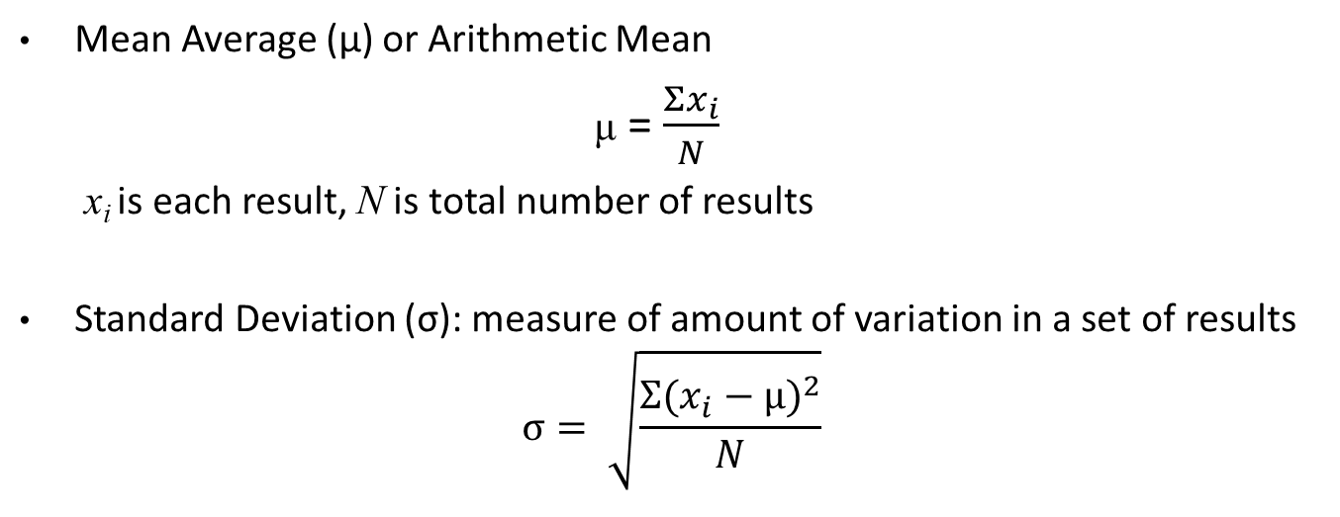
Some Stats Recap
Mean Average (μ) or Arithmetic Mean
μ = $\frac{Σx_{i}}{N}$
x_{i} is each result, N is total number of results
Standard Deviation (σ): measure of amount of variation in a set of results
$$σ= \sqrt{\frac{{Σ(x_{i}−μ)}^{2}}{N}}$$

Slide 19
Normal Distribution
Frequency of occurrence
Result or variable
Notes:
If I were to poll all of you for your shoe size, I would probably create a histogram that looks a little like this, and this is what we call a “normally distributed” variable. There will be more of you with a close to average shoe size and far fewer with very small or very big shoes. Shoe size is a discrete variable, as each shoe size jumps by at least half a size to the next one, so it only approximates a smooth curve.

Slide 20
Normal Distribution
Also known as Gaussian distribution or a “bell curve”
Symmetrical distribution with exactly half of results on each side of mean (no bias)
Mean = Median = Mode
Notes:
If I were to create a similar plot of all of your heights however, as a continuous variable it would give a smooth curve, and the more data points you have the more smooth the curve becomes. The exact shape of this distribution is called Normal Distribution – there are other shapes of distribution and not every dataset will fit a normal distribution, but it’s this one relevant to us because measurement errors do fit this curve.

Slide 21
Normal Distribution
Smaller standard deviation: taller and sharper curve
Notes:
A smaller standard deviation will result in a narrower distribution where more results are clustered closer to the mean, giving a taller and sharper curve.

Slide 22
Normal Distribution
Smaller standard deviation: taller and sharper curve
Larger standard deviation: shorter and broader curve
Notes:
…and a larger standard deviation conversely will give a shorter and broader curve. This means the likelihood of results falling quite far from the mean increases.

Slide 23
Normal Distribution
μ - 1σ
μ
μ + 1σ
± 1 standard deviation from the mean: 68.27% of all results
ie. for every ~3 results, expect 1 to be outside 1SD
68.27%
Notes:
As the shape of the bell curve is a function of the standard deviation, the values of the mean plus or minus standard deviation will always fall at the same relative point on the curve. This middle section of the bell curve, between the points that are minus and plus one standard deviation from the mean (shown by the green lines), encompasses 68.27% of all the results. So roughly one in every three results will fall outside these green lines.

Slide 24
Normal Distribution
μ - 2σ
μ
μ + 2σ
± 2 standard deviation from the mean: 95.45% of all results
ie. for every ~22 results, expect 1 to be outside 2SD
95.45%
Notes:
…but note that 1 in 22 refers to just results that are a little further from the mean purely due to random variance/fluctuations in the results. So be aware there might be other results that are outwith these points due to actual error.

Slide 25
Normal Distribution
μ - 3σ
μ
μ + 3σ
± 3 standard deviation from the mean: 99.73% of all results
ie. for every ~370 results, expect 1 to be outside 3SD
99.73%
Notes:
You will appreciate that this is a much rarer occurrence – unless you have many many data points, a result that falls outwith these points is very likely to be erroneous and NOT a result of random chance.

Slide 26
Control Chart Setup Normal Distribution Principles in a Control Chart
μ + 3σ
μ + 2σ
μ
Result
μ - 2σ
μ - 3σ
Repetition number (or date)

Slide 27
Control Chart Setup Fixed Mean vs Rolling Mean
μ + 3σ
μ + 2σ
μ
μ - 2σ
μ - 3σ

Slide 28
Control Chart Setup Fixed Mean vs Rolling Mean
μ + 3σ
μ + 2σ
μ
μ - 2σ
μ - 3σ

Slide 29
Control Chart Setup Fixed Mean vs Rolling Mean
μ + 3σ
μ + 2σ
μ
μ - 2σ
μ - 3σ

Slide 30
Control Chart Interpretation Outright Failures
μ + 3σ
μ + 2σ
μ
μ - 2σ
μ - 3σ
Notes:
In this control chart there are a couple of instances of failure * - 2 consecutive points outwith 2 standard deviations – one on its own could be a result of random chance, remember this should occur for 1 in roughly 20 points, but the chances are much much slimmer to get 2 consecutive points outwith 2 standard deviations. This would indicate some sort of issue with the process or method that would require investigating.
1 point outwith 3 standard deviations – the likelihood of this happening by random chance is 1 in 370, very rare. It’s much more likely that there has been an issue with the process or method that would require investigating.
In either of these cases, we have to assume that samples associated with these QC results would also be affected by the same issue that caused the QC failures. We wouldn’t usually be able to report these results.

Slide 31
Control Chart Setup Fixed Mean vs Rolling Mean
μ + 3σ
μ + 2σ
μ
μ - 2σ
μ - 3σ
Notes:
Replace for straight mean version

Slide 32
Control Chart Setup Fixed Mean vs Rolling Mean
μ + 3σ
μ + 2σ
μ
μ - 2σ
μ - 3σ

Slide 33
Control Chart Interpretation Bias
μ + 3σ
μ + 2σ
μ
μ - 2σ
μ - 3σ
Notes:
Here we don’t have any outright failures, but I’ll draw your attention to this section of points in the middle * – here we have 10 points that are all on the same side of the mean. That’s what’s known as a bias. This situation would indicate something has gone slightly awry with the process or method, as if it was performing as expected all results should have an equal chance of falling on either side of the mean. This would need to be investigated, although rejecting associated sample results is not necessary in most cases.

Slide 34
Control Chart Interpretation Drift
μ + 3σ
μ + 2σ
μ
μ - 2σ
μ - 3σ
Notes:
This is something that can be thought of as a more extreme form of bias, I hope you don’t need my * big red arrow to see the upward trend, or Drift, in these results. Again no single point has outright failed, this means that the control chart needs closer monitoring to pick up on effects like bias and drift. Especially as in real life the effect may be more subtle than I have shown here. This situation would also be cause for an investigation. It’s always good practice to rule out instrument issues but just remember for drift in particular, it is quite commonly caused by deterioration of the QC sample itself.

Slide 35
Control Chart Interpretation Periodic Step Changes
μ + 3σ
μ + 2σ
μ
μ - 2σ
μ - 3σ
Notes:
Here again, every point is within acceptable limits on its own (remember a single point outwith 2SD could be down to random chance) but you will notice at regular intervals in this chart*, results climb quite high then drop down suddenly. This effect can be a reflection of the routine of the method, maybe it is the preparation of new calibration standards or some instrument maintenance. This is why it is good practice to note in the QC chart when such events have occurred, so that when looking back you can match up the step change to the method event and assign a likely cause. I’m afraid to say if these events are causing a pattern in results like this, you are not preparing new calibration standards or performing the instrument maintenance *quite* often enough. Again for the purposes of demonstration, in this chart the periodic changes are quite obvious as the time interval is quite small, in your real life chart you may have to inspect more carefully to spot subtle periodic patterns.
Monitoring sugars electrode deterioration

Slide 36
Control Chart Interpretation Analyst Variation
μ + 3σ
Analyst C
Analyst B
Analyst C
Analyst C
Analyst B
μ + 2σ
Analyst B
Analyst B
μ
μ - 2σ
Analyst A
Analyst A
Analyst A
μ - 3σ
Notes:
One final point to watch out for, this QC chart might look all in order at first glance but on further inspection * we find a pattern related to the analysts performing the method. In this instance it would be worth gathering all analysts together and finding out what Analyst A is doing differently to Analysts B and C. It might be that Analyst A requires some re-training, but they might also have unconsciously hit upon an improvement to the method that everyone else can learn from.

Slide 37
Control Chart Management Removal of Points from Mean and SD Calculations

Slide 38
Control Chart Management Method Uncertainty
Notes:
Importance, how to calculate, use as basis for ongoing performance monitoring (reviewed annually)
NORDtest (needs ERMs or good proficiency schemes)
JC

Slide 39
Control Chart Management Recording of issues
Notes:
Root cause analysis (TAs)
Examples of issues we’ve discovered eg apparent strength seasonal bias

Slide 40
Proficiency Schemes

Slide 41
Standardization – z-scores
Z* scores
J scores?
Notes:
JF – assigned values can depend on scheme or method. Mean/median, exclusion outliers. Simulants – (target values)
Methods – esp. MAPS NIR vs wet chem, all compared together.
Wide BIPEA ranges.

Slide 42
Internal Round Robins
Notes:
Multiple labs/sites in one company.

Slide 43
Training
Notes:
Records/signoffs.
Checking (transcription)

Slide 44
Thank you for your attention
Hannah Ford
Analytical Research Scientist
hannah.ford@swri.co.uk
Shona Harrison
Analytical Services & Laboratory Manager
shona.harrison@swri.co.uk
Notes:
And that brings us to the end, thanks very much for paying attention to me. We’ll take any questions at this point, or if you think of one later or if you’re watching the recording of this, feel free to contact me at the email above.

